Slide 1
Programming for Teens: The Good The Bad and The Lonely
Presented by:
Christen Orbanus, Teen Librarian, Vogelson Branch, Camden County Library

Slide 2
Getting Teens to Come to Programs Can be Hard!

Slide 3
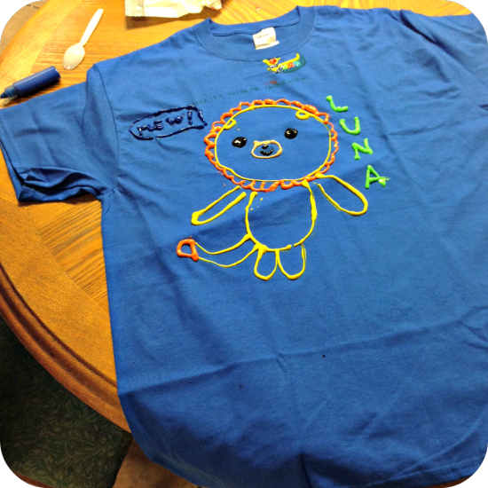
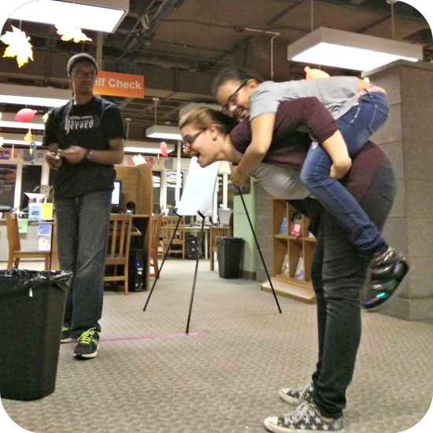
After Hours

Slide 4
Dystopian Lock In

Slide 5
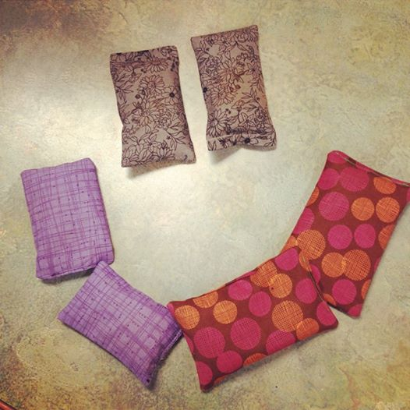
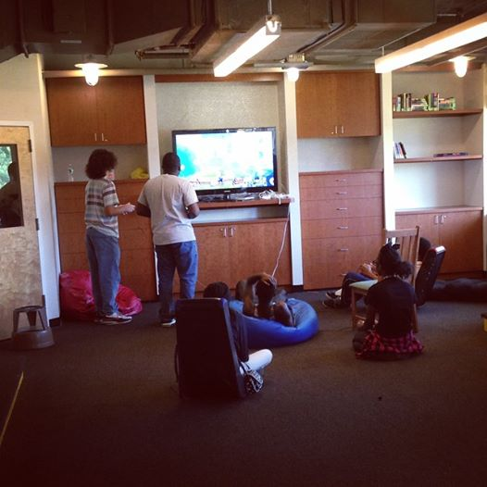
Program Successes
6th Grade Pizza Party
Create Your Own Program {Prize}
Weekly Gaming Club
Sew Fantastic
Movie Making Mondays

Slide 6
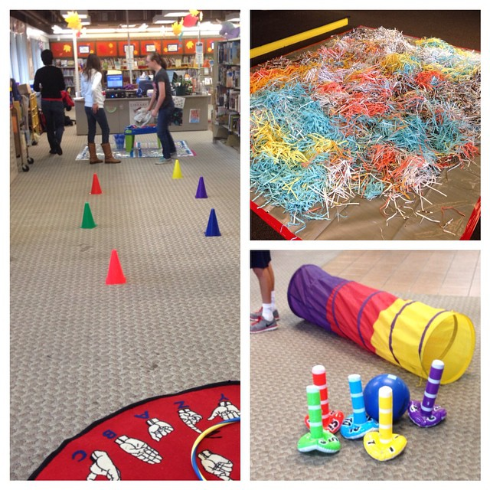
Volunteers
75 Volunteers in 2014
639 service hours completed!
Book Buddies/ Math Buddies/ Teen Volunteer Power Hour
Local High School {2 hours Freshman year for Health Class requirement}

Slide 7
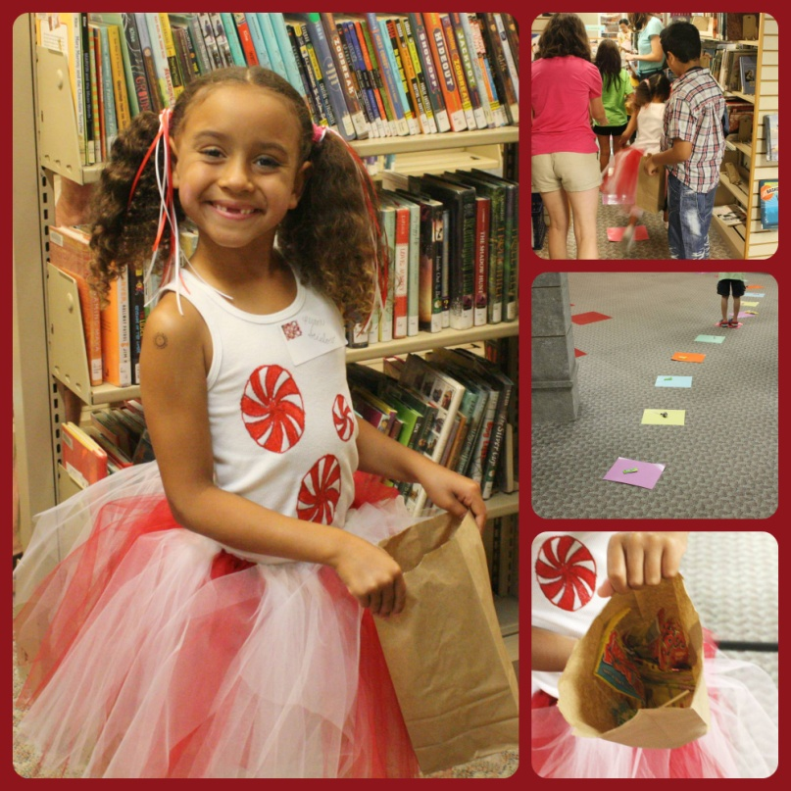
Putting Volunteers to Work
Live Action Candyland
Community Play Date
Halloween Family Fun Night
SUMMER READING!!!!

Slide 8
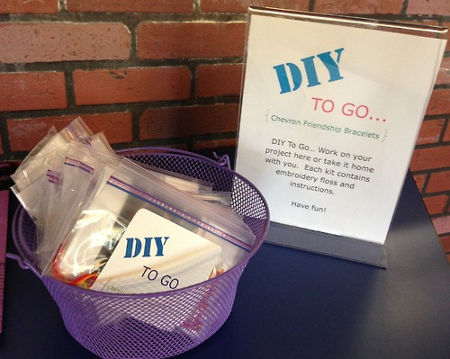
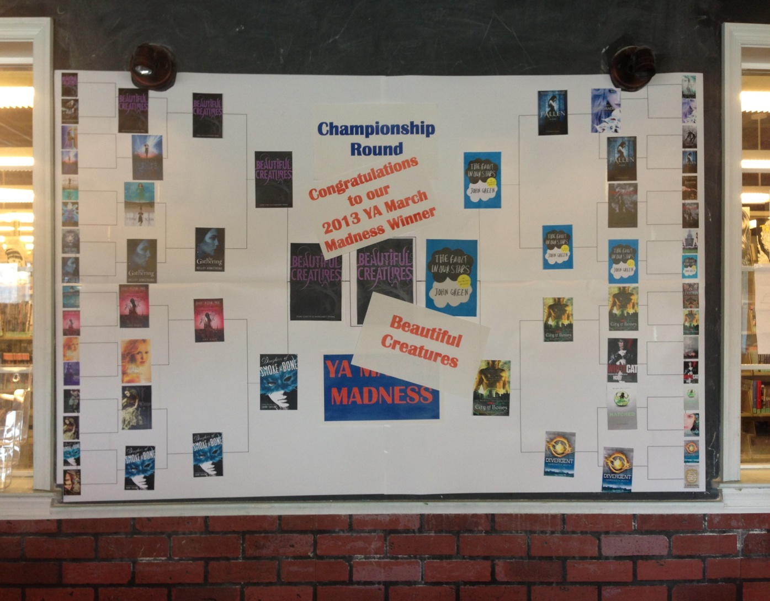
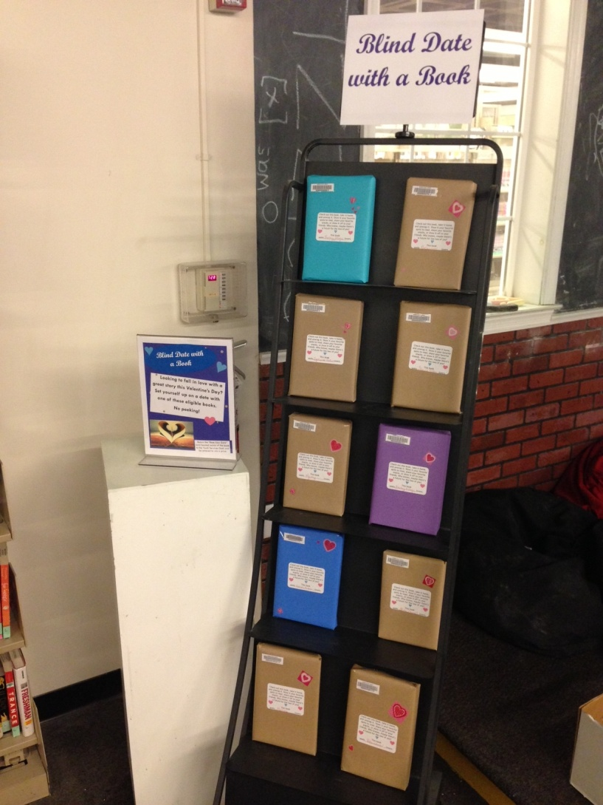
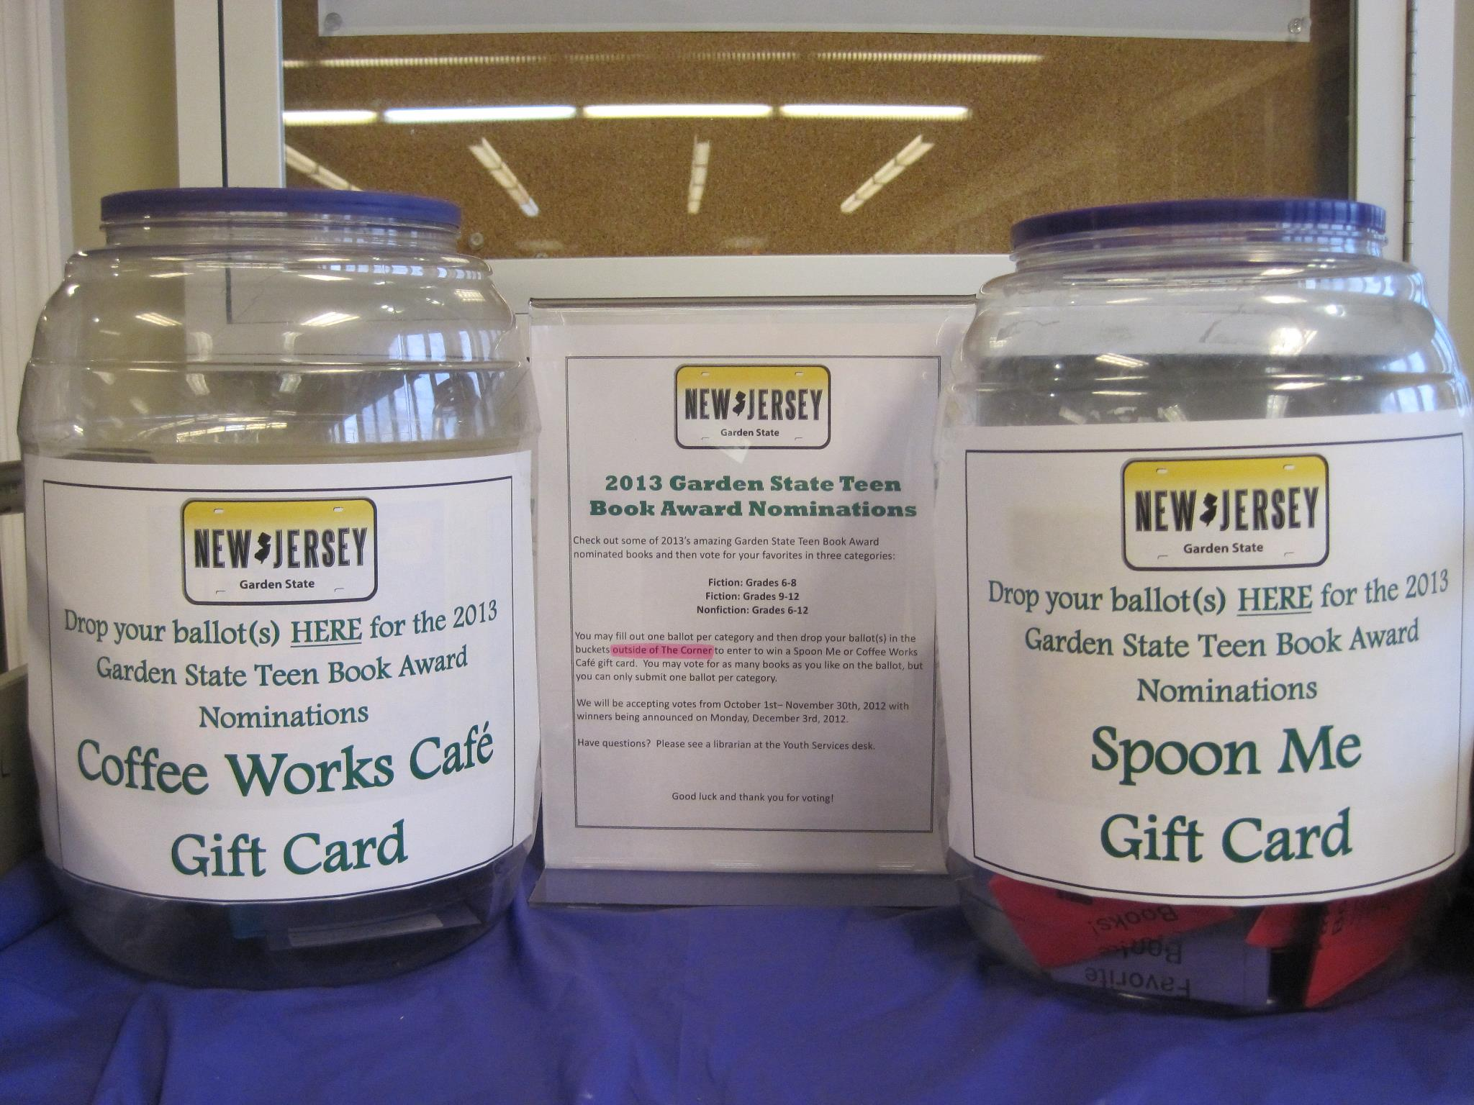
Self Directed Programming
***Dropbox: http://tinyurl.com/kbxvpgv***
YA March Madness
YA Book Brawl
Garden State Teen Book Awards Ballots
Blind Date with a Book
DIY to Go
Instagram {@CCLTeens}

Slide 9
Thank You
Christen Orbanus, Teen Librarian
Vogelson Branch, Camden County Library
856-772-1636 x7360
corbanus@camdencountylibrary.org

