Slide 1
Teen Programming 101
Free & Low Cost Programs, Themed Parties and Big Events
Saleena Davidson
YA Librarian
South Brunswick Public Library
732-329-4000 ext 7634
sdavidson@sbpl.info

Slide 2
Something for Nothing (Well, almost)
Tips: Potluck events
Donations (if you can get them)
Don’t be afraid to borrow!
Use what you know
Be aware of local resources

Slide 3
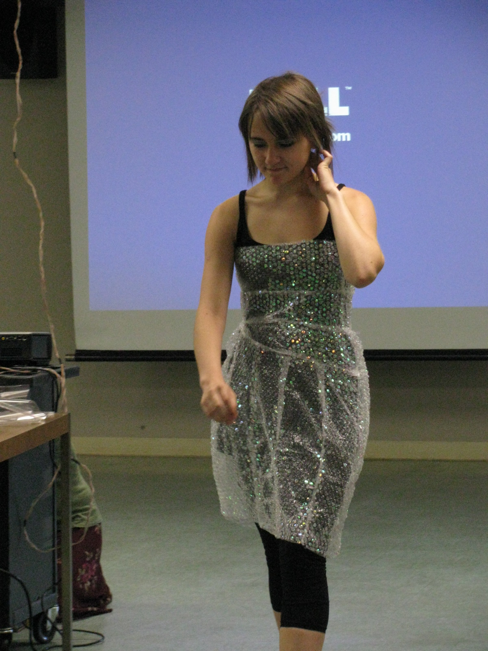
Examples!!!

Slide 4
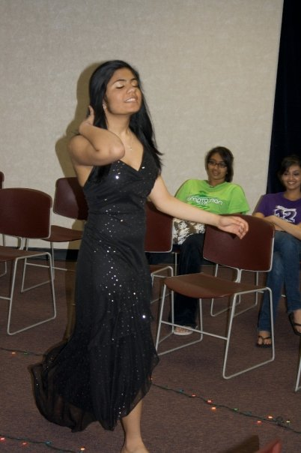

Slide 5
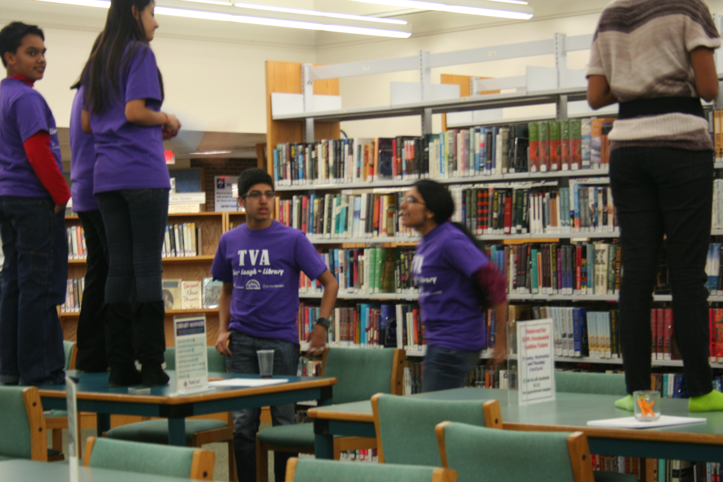

Slide 6
Themed Parties!

Slide 7
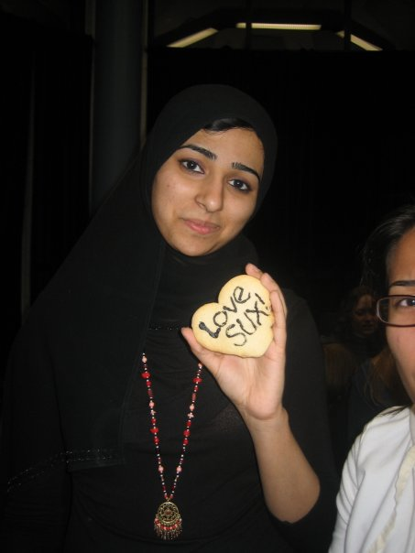
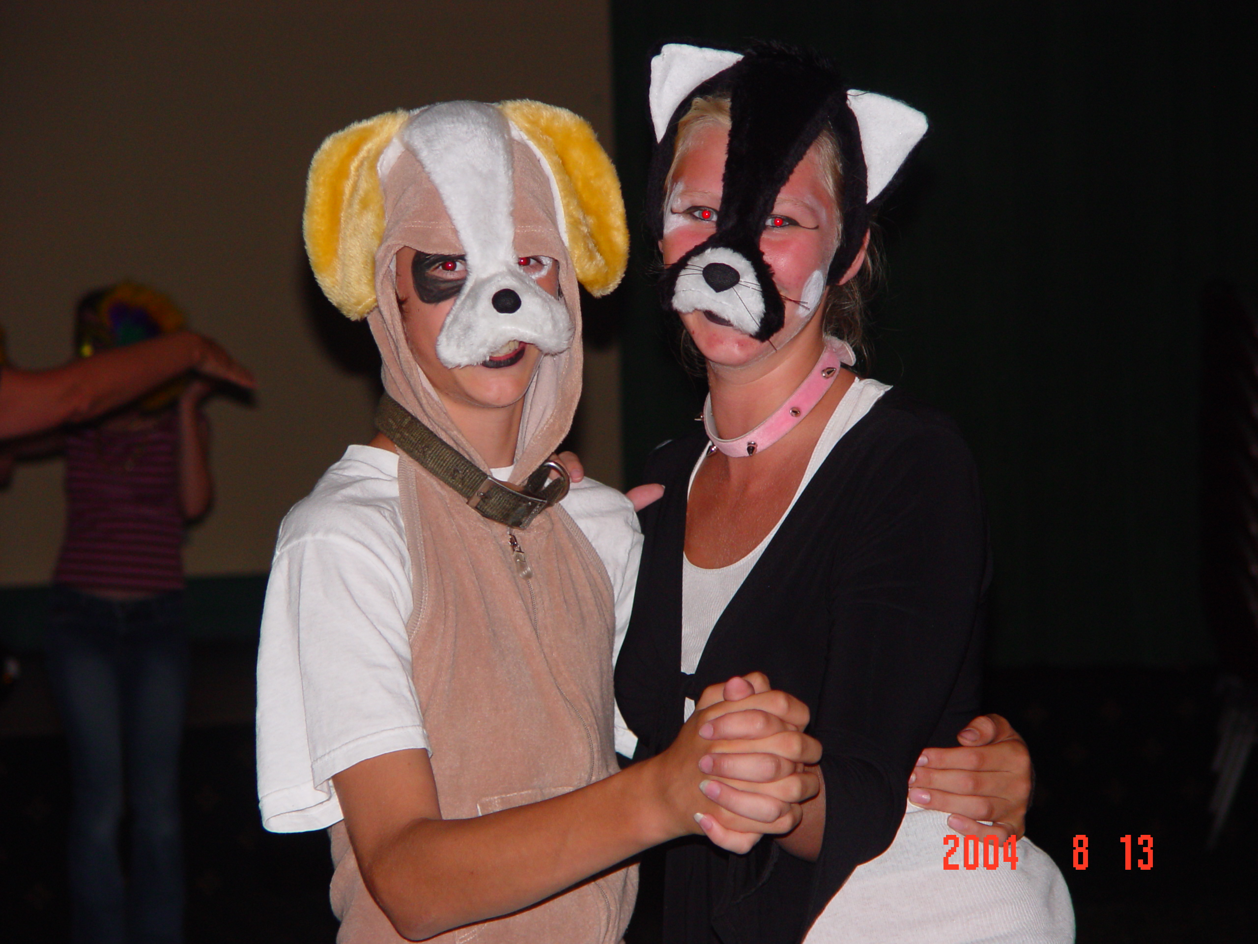

Slide 8
Big Events (Yes You CAN!!)
Tips: Use local resources (don’t be afraid to ask!)
Take advantage of your teens’ passions (it will translate into bigger audiences)
Prioritize your spending

Slide 9
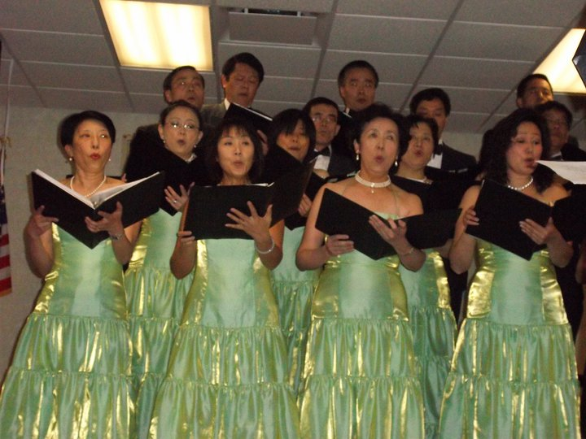
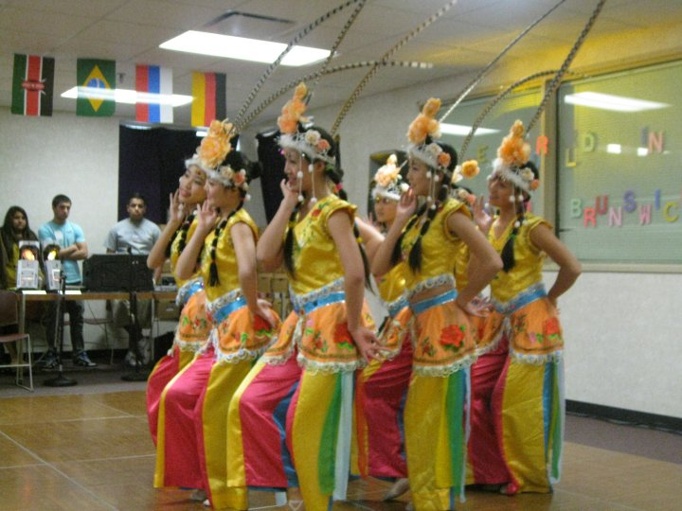

Slide 10
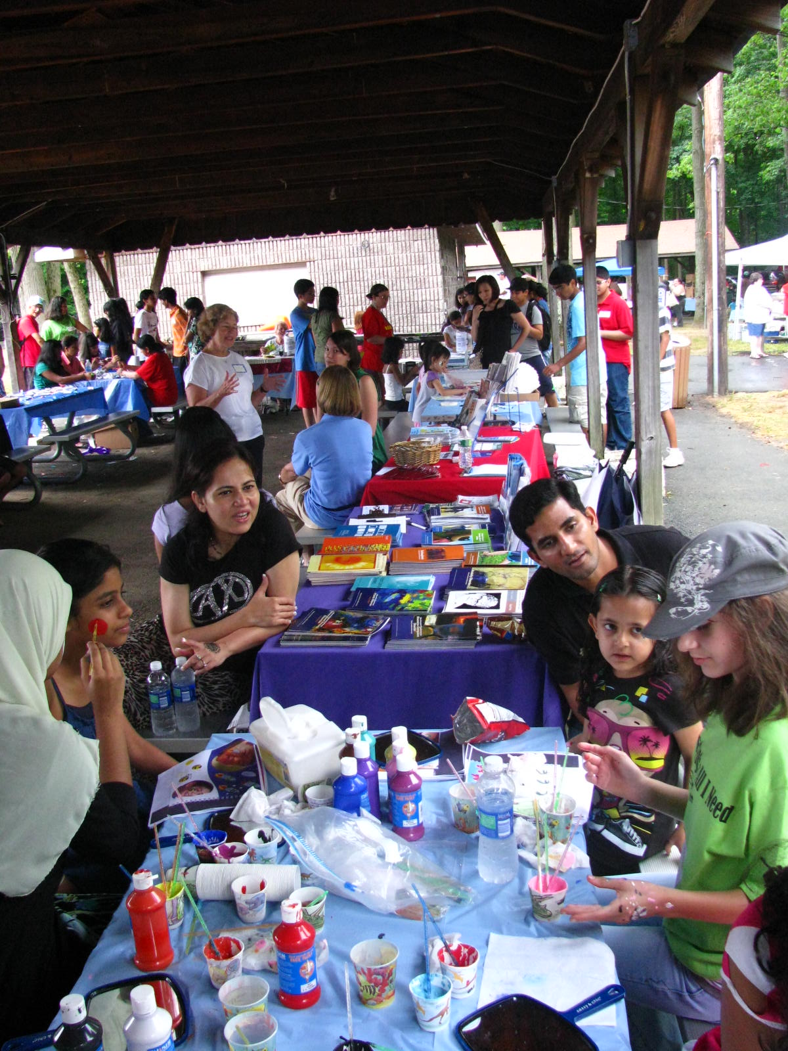
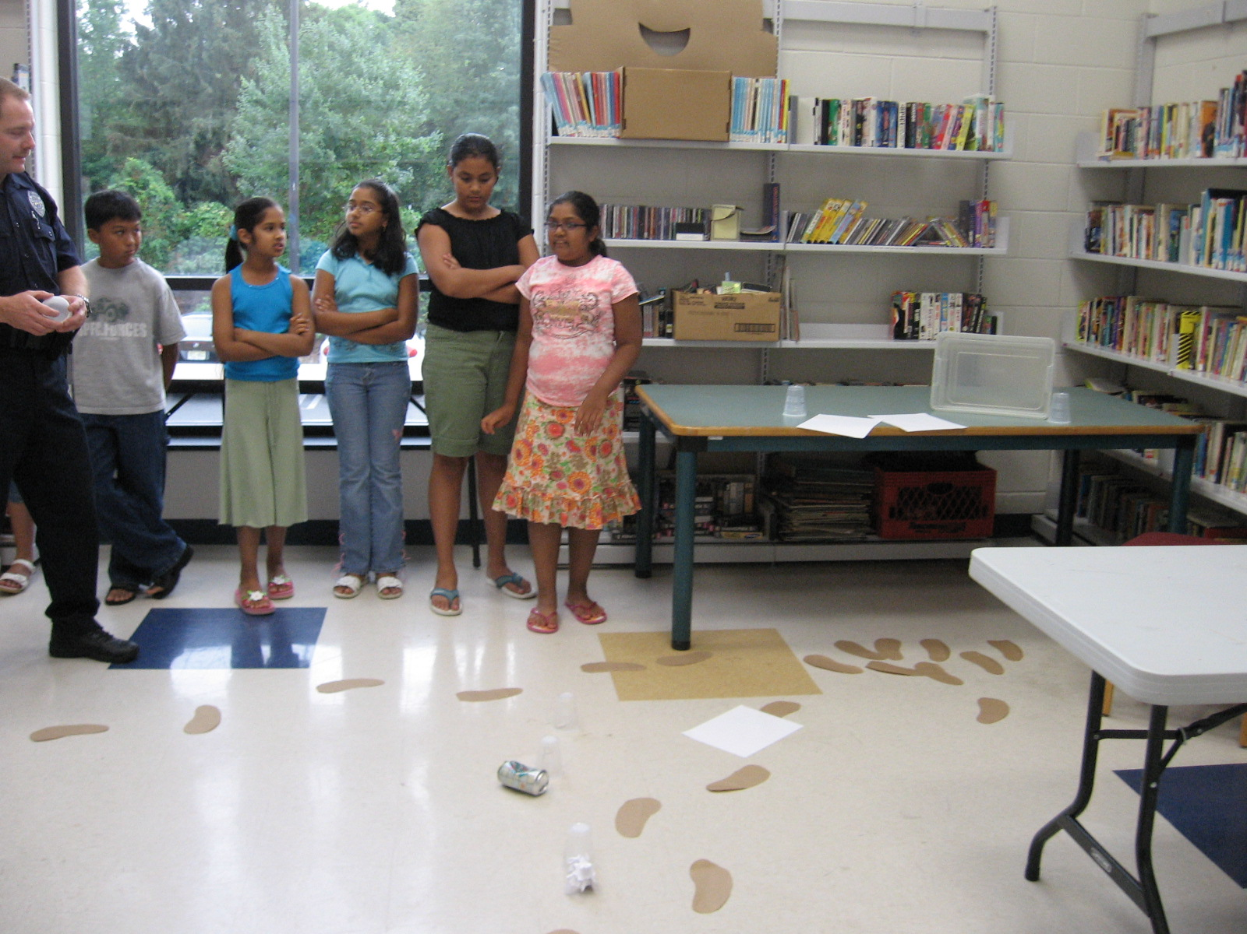

Slide 11
